Slide 1
AI Chatbot (Domain Specific)
Submitted by
<Hafiz Abdur Raheem Usama (Cs-142060)>
<Shah Abdul Aziz (Cs-142056)>
<Muhammad Arsalan Ahmed (Cs-141012)>
Supervisor
<Associate Professor Dr. Hiro Takahashi>

Slide 2
Topic to be covered here:
Introduction
Project Vision
Project Scope
Proposed Methodology
Project Planning
Project Requirements
Budget/costing
Deliverables
Proposed GUI
References

Slide 3
Introduction
What is chat bot?
“Chat bots are program that people interact with through messaging and conversion”
Why chat bot are trending?
Tech giants like FACEBOOK, GOOGLE, MICROSOFT, AMAZON are all taking chat bots to a whole new level
Facebook is turning its messenger app into a platform that supports Chat bots
In the advance countries like US UK Canada even small business tend to have chat bot to provide customer service
Notes:
Summarize your research in three to five points.

Slide 4
Introduction
“CHATBOTS ARE BOOMING..THANKS TO THE BIG BETS OF TECH GIANTS LIKE MICROSOFT, FACEBOOK, AMAZON, ETC. THANKS TO THE COMMODITIZATION OF MANY ALGORITHMS AND LIBRARIES FOR NLP EASY TO USE AND DEPLOY. THANKS TO THE INCREASING MASS ADOPTION OF MESSAGING AND TALKING TO TECHNOLOGY AS HUMAN-COMPUTER INTERACTION.”
ALBERTO CHIERICI - CO-FOUNDER, SPIXII

Slide 5
Problem Statement
It is almost impossible to take care of every student and do their career counselling.
Student are unaware of the advancement happening in the modern world
Most of them did not even know what is best for them, what to study and where to study
Universities have other works to do, they cannot listen the case of every single student and suggest them what is the best for their career
Then?
We need a virtual assistant that do the counselling of the students 24/7 and recommend them the best possible option

Slide 6
Project Motivation
What motivate us?
Business are seeing the benefit of having a chat bot to provide scalable customer service
Majority of the businesses heard about Chat bots for the first time between 2015 and 2016
The market is not saturated and thus we can have a chance as well. There are many business that can have the benefit of having chat bot
For example:
E-commerce, Insurance, Health care etc

Slide 7
Objectives
To develop an AI Chat Bot that communicate with user in natural language
Recommend them the best suitable solution for them
Using Machine learning & Natural language processing
By the time, the bot will become more and more “intelligent” and improve its performance
Optional functionalities: voice recognition

Slide 8
Project Vision
An AI Chatbot (Domain Specific) that will communicate with the user in the natural language and recommend the best career option for them.

Slide 9
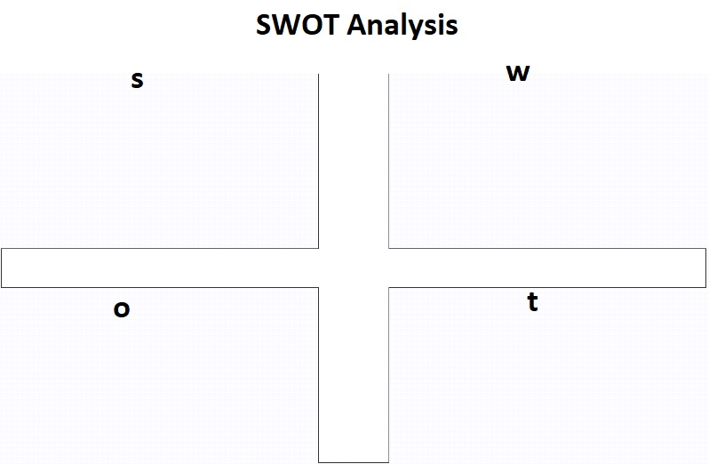
SWOT Analysis
Chat bots on its own are nothing they need data to take decision
Chat bots will not completely replace humans.
The domain specific Chabot cannot even understand a single word out of their domain.
Chat bots rely on content, not just technology
Reduction of cost for operation
24/7 support
Response rate increase
Improved customer service.
Improved customer intelligence.
Improved sales and business opportunity.
Stand-alone Chat bots are expected to contribute 40% of the market by 2022.
Consumer Cha bot applications will continue to lead the market.
Almost every business wants to have their own Chat bot to provide scalable customer
Companies adopting to Chabot will need to have rigorous security protocols.
The Chabot contains private and confidential data of business. In case of any attack there is a huge risk to lose confidential data about business and customers.

Slide 10
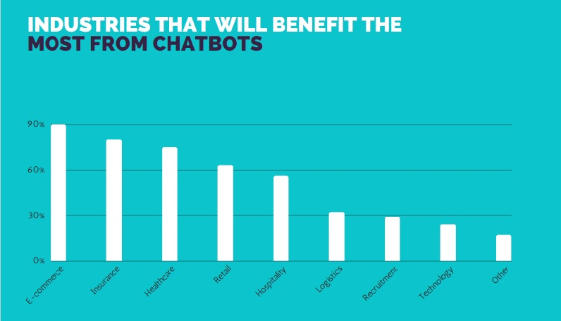
Business Opportunity

Slide 11
Business Opportunity
Industries that will reap the maximum benefit from chat bots are
E- commerce (2)Insurance (3)health
Customer service function will benefit the most from Chatbots followed by Sales/Marketing and
Order Processing.
There are lots of business who want chat bot.
What if they have a chat bot without even having any programming skills?

Slide 12
Customer Needs
The chat bot are in demands, the business can improve their customer service customer intelligence
Intelligent virtual assistant
Improve sales and business opportunity
Cost reduction
24/7 support
Provide service multiple customers at a time

Slide 13
Success Criteria
The success criteria of this AI Chat bot will be measure after its release in the market. How users adopt to this Chat bot, how their experienced is and their satisfaction level about the Chat bot

Slide 14
Project Scope
The project scope is comprised of five main aspects, collecting the data, training the bot, the natural languages supported, and the pool of our recommendation results, testing and the host platforms.
Collecting data
Training the bot
Natural Languages
Recommend Models
Host Platforms

Slide 15
Project Scope
Collecting data
The Data is very critical in determining the accuracy and the performance of our Chatbot. Therefore, we will spend some time collecting adequate data from several possible sources

Slide 16
Project Scope
Training the bot
The data is very important for the training of the bot. the more data mean the more accurate our bot is

Slide 17
Project Scope
Natural Languages
The bot to understand the English language naturally and contextually. Determine the intent of the users, what they actually want, to identify concepts and entities in a given sentence, and to respond with the appropriate action

Slide 18
Project Scope
Recommend Models
The chat bot will recommend the user the best possible option for them. While recommending the bot also look into the previous similar user problems and what the bot had recommend them

Slide 19
Project Scope
Host Platforms/ Messaging Apps
Facebook messenger
Slack
Skype
Websites
Kik messenger
Wechat

Slide 20
SDLC Approach
The SDLC approach we are following is Agile
Agile is most common and rapid development method
After the completion of every component we will move on to the other, which if there is some changes in requirement we can adopt it
Why agile suits us best is, we can also involve the client in the development
Waterfall would make the training of the bot irreversible

Slide 21
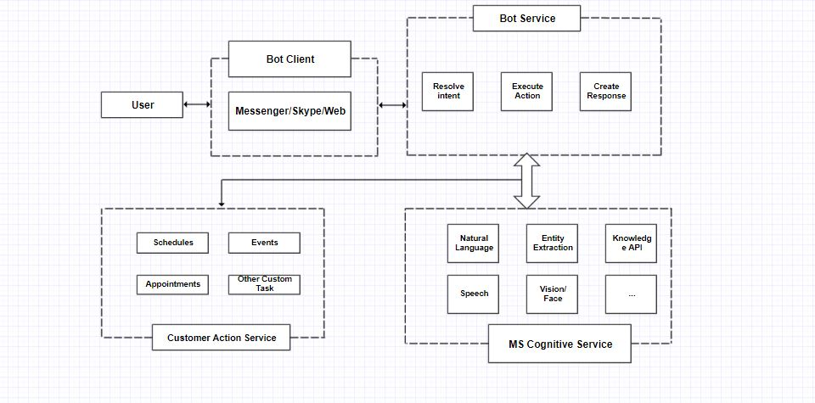
High level Architecture / Design

Slide 22
Testing
At the initial stage of testing, we will come up with our own pre-defined set of questions to be input to the bot, like “Is university XXX better than university YYY”, to see whether a desired output will be returned or not. Results of test cases will be stored in a log file with time-stamps so that progress of refinement of the bot will be recorded for further development.

Slide 23
Testing techniques
We will also follow some testing techniques as well
User Acceptance Testing
Unit Testing
Integration testing
Component Testing
System Testing

Slide 24
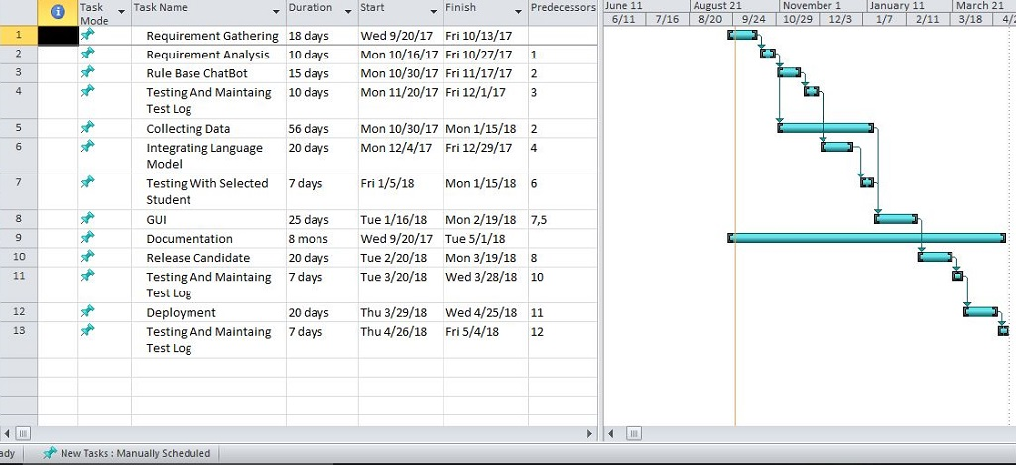
Project Planning

Slide 25
Project Requirements
Software tools requirements
Microsoft Bot framework
Azure Machine Learning Studio
Language Understanding Intelligent Service (LUIS)

Slide 26
Budget/Costing
SOFTWARE USED | COST
MS Office | Using Free trial Version for 1 year
Microsoft Azure | Pay only what you use, no upfront cost Will be using 1 year free trial version
Visual Studio Community Version | Using Free version with 1 year trial
Microsoft Cognitive Services(LUIS API) | $0.75 per 1,000 transactions

Slide 27
Budget/Costing
We have fixed the cost of each developer for this project. We are three team members, and every member will cost 25,000 each to complete this project. Since this is our project we are charging very low.

Slide 28
Project Deliverables
The project deliverables phase consist of four main aspect
Phase I - Alpha Prototype
Will develop a runnable bot that can give respond to the pre-defined question
Phase II - Beta Prototype
In this phase we will integrate Natural Language Processing, the Machine Learning techniques and the language model into the bot framework, and find a suitable recommendation algorithm.
Phase III - Release Candidate
The milestone of this stage is the final product of the bot before its deployment, with all features implemented and tests passed
Phase IV - Final Product
The final product an Ai Chat bot with user friendly GUI

Slide 29
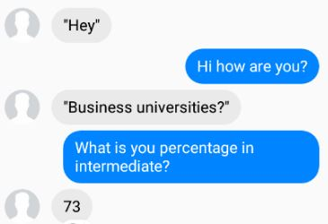
Proposed GUI

Slide 30
Reference
[1] AI And Chatbots Are Transforming The Customer Experience. july 15, 2017.
Source: Source:https://www.forbes.com/sites/shephyken/2017/07/15/ai-and-chatbots-are-transforming-the-customer-experience/#5e7e481841f7
[2] Chatbots And The Future Of Conversation-Based Interfaces: May 24, 2016.
Source: https://www.forbes.com/sites/danielnewman/2016/05/24/chatbots-and-the-future-of-conversation-based-interfaces/#2d2e53311fc7
[3] How Chatbots Are About To Change Communication: JUL 24, 2017
Source: https://www.forbes.com/sites/laurencebradford/2017/07/24/how-chatbots-are-about-to-change-communication/#13be15f44aa8

Slide 31
Reference
[4] Language Understanding Intelligent Service, Add conversational intelligence to your apps.
Source: https://www.luis.ai/home
[5] Learn About the Bot Framework and how it can help us.
Source: https://docs.microsoft.com/en-us/bot-framework/overview-introduction-bot-framework
[6] Add intelligence to bots with Cognitive Services.
Source: https://docs.microsoft.com/en-us/bot-framework/cognitive-services-bot-intelligence-overview
[7] Principles of bot design: AUGUST 4, 2017
Source: https://docs.microsoft.com/en-us/bot-framework/bot-design-principles

Slide 32
Reference
[8] How the Bot Framework works, Building the bots.
Source: https://docs.microsoft.com/en-us/bot-framework/overview-how-bot-framework-works
[9] Chatbots Survey 2017 [Chatbot Market Research Report]
By Ayush Jain, Co-founder & CEO at Mindbowser & Chapter Director at Startup Grind
[10] The Complete Beginner’s Guide To Chatbots: Apr 20, 2016
Source: https://chatbotsmagazine.com/the-complete-beginner-s-guide-to-chatbots-8280b7b906ca

Slide 33
Reference
[11] Survey on Chatbot Design Techniques in Speech Conversation Systems.
(IJACSA) International Journal of Advanced Computer Science and Applications,
Vol. 6, No. 7, 2015
[12] A python chatbot framework with Natural Language Understanding and Artificial Intelligence.
Source: https://github.com/alfredfrancis/ai-chatbot-framework
[13] Stack Overflow uses Microsoft AI tech to create a chat bot that assists software developers.
Source: https://www.geekwire.com/2017/stack-overflow-uses-microsoft-ai-tech-create-chat-bot-assists-software-developers/

Slide 34
Reference
[14] SBI launches chatbot to help customers in banking activities.
Source: http://economictimes.indiatimes.com/industry/banking/finance/banking/sbi-launches-chatbot-to-help-customers-in-banking-activities/articleshow/60827485.cms
[15] Bot Framework at Microsoft Ignite 2017.
Source: https://blog.botframework.com/2017/09/25/bot-framework-microsoft-ignite-2017/
[16] Natural Language Understanding Services – a comparison.
Source: https://blog.botframework.com/2017/09/20/natural-language-understanding-services-comparison/

Slide 35
The End
Thank You

